Slide 1
EDUCATION TRASFORMATION EMPOWERING WOMEN IN INDIA
Analyzing the Growth in Educated Female Population in INDIA
A Data Driven Perspective

Slide 2
SOURCE OF THIS DATA
Information about source:
The World Bank is a renowned international financial institution that provides financial and technical assistance to countries worldwide, with a mission to alleviate poverty, promote sustainable development, and support economic growth. The World Bank plays a pivotal role in gathering and disseminating valuable global data to facilitate evidence-based decision-making and foster socio-economic progress.
The data for this analysis was collected from the World Bank's Open Data source, specifically the database containing information on total population, education levels, subsamples (such as rural, urban, male, female, high education, low education), region names, and country names. The dataset spans from 1980 to 2021, enabling a comprehensive examination of the trends in population and education over time. By filtering the data to extract the relevant information for our analysis, we have focused on the key variables necessary to gain insights into the growth in education and population dynamics.

Slide 3
TABLE OF CONTENTS
01
02
03
DEMOGRAPHICS
CONCLUSION
DATA OVERVIEW
Analyzing the Growth in Female Education
Utilized Power BI with DAX functions for data analysis
Rising education, declining uneducated population

Slide 4
01
DATA OVERVIEW
Female Education Leve Distribution in INDIA

Slide 5
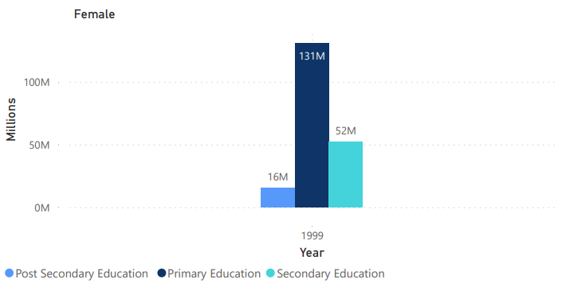
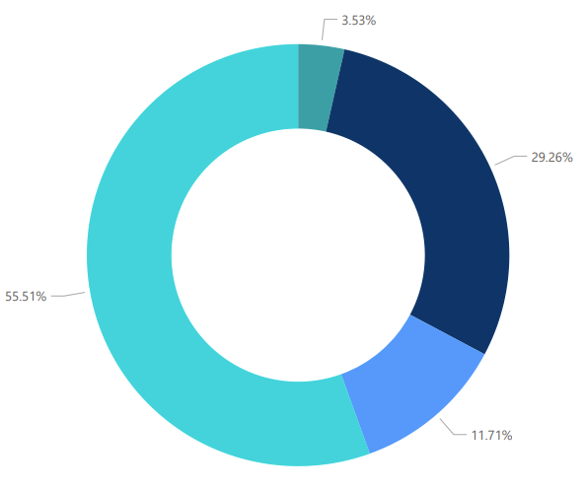
.
Education Level Distribution among Women in 1999
The bar chart showcases the population numbers of women in different education levels in the year 1999
The pie chart illustrates the distribution of women's education levels in the year 1999, with primary education accounting for 34.6%, secondary education for 46.3%, and post-secondary education for 19.1% of the total educated population.

Slide 6
02
DEMOGRAPHICS
Changing Demographics: Female Education Trends in India

Slide 7
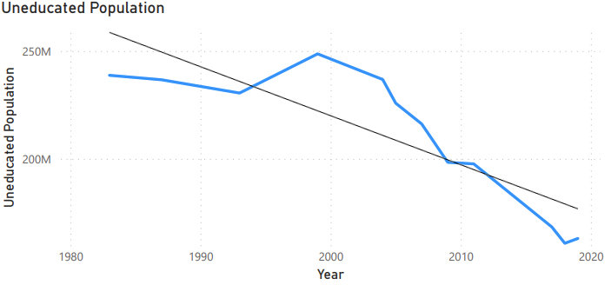
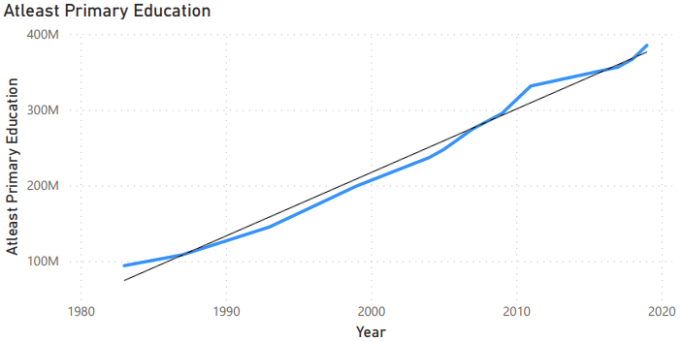
.
Education Dynamics Decline & Growth
The highest rate of growth was observed between the years 1999 and 2009, with an increase of 53.6 million females, representing a growth rate of 4.3% per year during that period.
The highest rate of decline was observed between the years 1983 and 1993, with a reduction of 8.2 million uneducated females, representing a decline rate of 3.5% per year during that period.

Slide 8
03
CONCLUSION
Fluctuations and Trends in Female Education: A Closer Look

Slide 9

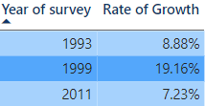
RESULTS
2005: The growth rate was -0.07%, indicating a decline or stagnation in the educated female population compared to the previous year.
2011-2017: The growth rate fluctuated with a decline of -0.81%. This period experienced a decrease in the growth rate, suggesting a slowdown.
While some periods witnessed significant growth, others experienced slight declines or slower growth rates. Overall, the data indicates an improvement in the education levels among females in India, although the growth rates fluctuated across different time periods.

Slide 10
THANK YOU
Do you have any questions?

